Slide 1
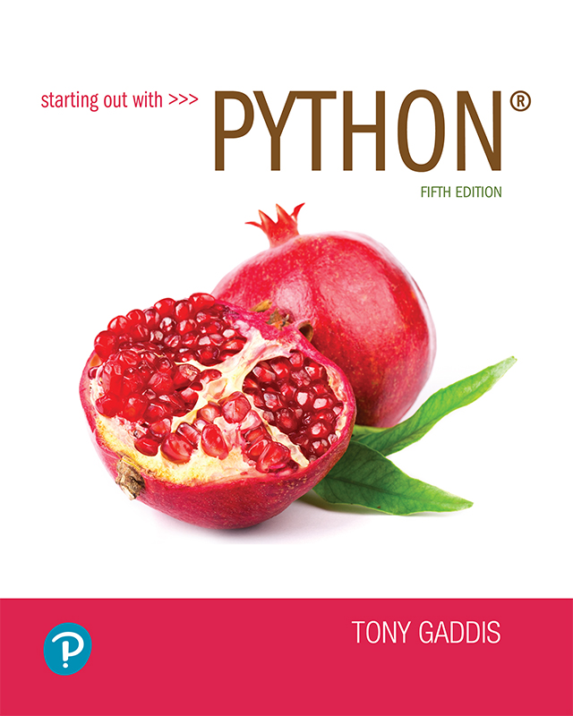
Starting out with Python
Fifth Edition
Chapter 2
Input, Processing, and Output
Copyright © 2021, 2018, 2015 Pearson Education, Inc. All Rights Reserved

Slide 2
Topics (1 of 2)
Designing a Program
Input, Processing, and Output
Displaying Output with print Function
Comments
Variables
Reading Input from the Keyboard
Performing Calculations
String Concatenation

Slide 3
Topics (2 of 2)
More About The print Function
Displaying Formatted Output
Named Constants
Introduction to Turtle Graphics

Slide 4
Designing a Program (1 of 3)
Programs must be designed before they are written
Program development cycle:
Design the program
Write the code
Correct syntax errors
Test the program
Correct logic errors

Slide 5
Designing a Program (2 of 3)
Design is the most important part of the program development cycle
Understand the task that the program is to perform
Work with customer to get a sense what the program is supposed to do
Ask questions about program details
Create one or more software requirements

Slide 6
Designing a Program (3 of 3)
Determine the steps that must be taken to perform the task
Break down required task into a series of steps
Create an algorithm, listing logical steps that must be taken
Algorithm: set of well-defined logical steps that must be taken to perform a task

Slide 7
Pseudocode
Pseudocode: fake code
Informal language that has no syntax rule
Not meant to be compiled or executed
Used to create model program
No need to worry about syntax errors, can focus on program’s design
Can be translated directly into actual code in any programming language

Slide 8
Flowcharts (1 of 2)
Flowchart: diagram that graphically depicts the steps in a program
Ovals are terminal symbols
Parallelograms are input and output symbols
Rectangles are processing symbols
Symbols are connected by arrows that represent the flow of the program

Slide 9
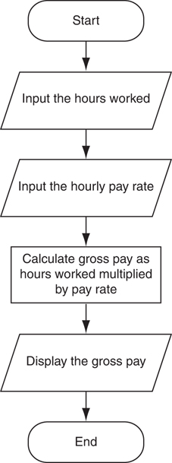
Flowcharts (2 of 2)
Figure 2-2 The program development cycle

Slide 10
Input, Processing, and Output
Typically, computer performs three-step process
Receive input
Input: any data that the program receives while it is running
Perform some process on the input
Example: mathematical calculation
Produce output

Slide 11
Displaying Output with the print Function
Function: piece of prewritten code that performs an operation
print function: displays output on the screen
Argument: data given to a function
Example: data that is printed to screen
Statements in a program execute in the order that they appear
From top to bottom

Slide 12
Strings and String Literals
String: sequence of characters that is used as data
String literal: string that appears in actual code of a program
Must be enclosed in single (') or double (") quote marks
String literal can be enclosed in triple quotes (''' or """)
Enclosed string can contain both single and double quotes and can have multiple lines

Slide 13
Comments
Comments: notes of explanation within a program
Ignored by Python interpreter
Intended for a person reading the program’s code
Begin with a # character
End-line comment: appears at the end of a line of code
Typically explains the purpose of that line

Slide 14
Variables
Variable: name that represents a value stored in the computer memory
Used to access and manipulate data stored in memory
A variable references the value it represents
Assignment statement: used to create a variable and make it reference data
General format is variable = expression
Example: age = 29
Assignment operator: the equal sign (=)

Slide 15
Variables (cont’d.)
In assignment statement, variable receiving value must be on left side
A variable can be passed as an argument to a function
Variable name should not be enclosed in quote marks
You can only use a variable if a value is assigned to it

Slide 16
Variable Naming Rules
Rules for naming variables in Python:
Variable name cannot be a Python key word
Variable name cannot contain spaces
First character must be a letter or an underscore
After first character may use letters, digits, or underscores
Variable names are case sensitive
Variable name should reflect its use

Slide 17
Displaying Multiple Items with the print Function
Python allows one to display multiple items with a single call to print
Items are separated by commas when passed as arguments
Arguments displayed in the order they are passed to the function
Items are automatically separated by a space when displayed on screen

Slide 18
Variable Reassignment
Variables can reference different values while program is running
Garbage collection: removal of values that are no longer referenced by variables
Carried out by Python interpreter
A variable can refer to item of any type
Variable that has been assigned to one type can be reassigned to another type

Slide 19
Numeric Data Types, Literals, and the str Data Type
Data types: categorize value in memory
e.g., int for integer, float for real number, str used for storing strings in memory
Numeric literal: number written in a program
No decimal point considered int, otherwise, considered float
Some operations behave differently depending on data type

Slide 20

Reassigning a Variable to a Different Type
A variable in Python can refer to items of any type
Figure 2-7 The variable x references an integer
Figure 2-8 The variable x references a string

Slide 21
Reading Input from the Keyboard
Most programs need to read input from the user
Built-in input function reads input from keyboard
Returns the data as a string
Format: variable = input(prompt)
prompt is typically a string instructing user to enter a value
Does not automatically display a space after the prompt

Slide 22
Reading Numbers with the input Function
input function always returns a string
Built-in functions convert between data types
int(item) converts item to an int
float(item) converts item to a float
Nested function call: general format: function1(function2(argument))
value returned by function2 is passed to function1
Type conversion only works if item is valid numeric value, otherwise, throws exception

Slide 23
Performing Calculations
Math expression: performs calculation and gives a value
Math operator: tool for performing calculation
Operands: values surrounding operator
Variables can be used as operands
Resulting value typically assigned to variable
Two types of division:
/ operator performs floating point division
// operator performs integer division
Positive results truncated, negative rounded away from zero

Slide 24
Operator Precedence and Grouping with Parentheses
Python operator precedence:
Operations enclosed in parentheses
Forces operations to be performed before others
Exponentiation (**)
Multiplication (*), division (/ and //), and remainder (%)
Addition (+) and subtraction (-)
Higher precedence performed first
Same precedence operators execute from left to right

Slide 25
The Exponent Operator and the Remainder Operator
Exponent operator (**): Raises a number to a power
x ** y = x^{y}
Remainder operator (%): Performs division and returns the remainder
a.k.a. modulus operator
e.g., 4%2=0, 5%2=1
Typically used to convert times and distances, and to detect odd or even numbers

Slide 26
Converting Math Formulas to Programming Statements
Operator required for any mathematical operation
When converting mathematical expression to programming statement:
May need to add multiplication operators
May need to insert parentheses

Slide 27
Mixed-Type Expressions and Data Type Conversion
Data type resulting from math operation depends on data types of operands
Two int values: result is an int
Two float values: result is a float
int and float: int temporarily converted to float, result of the operation is a float
Mixed-type expression
Type conversion of float to int causes truncation of fractional part

Slide 28
Breaking Long Statements into Multiple Lines (1 of 2)
Long statements cannot be viewed on screen without scrolling and cannot be printed without cutting off
Multiline continuation character (\): Allows to break a statement into multiple lines
result = var1 * 2 + var2 * 3 + \
var3 * 4 + var4 * 5

Slide 29
Breaking Long Statements into Multiple Lines (2 of 2)
Any part of a statement that is enclosed in parentheses can be broken without the line continuation character.
print("Monday's sales are", monday,
"and Tuesday's sales are", tuesday,
"and Wednesday's sales are", Wednesday)
total = (value1 + value2 +
value3 + value4 +
value5 + value6)

Slide 30
String Concatenation (1 of 2)
To append one string to the end of another string
Use the + operator to concatenate strings
>>> message = 'Hello ' + 'world'
>>> print(message)
Hello world
>>>

Slide 31
String Concatenation (2 of 2)
You can use string concatenation to break up a long string literal
print('Enter the amount of ' +
'sales for each day and ' +
'press Enter.')
This statement will display the following:
Enter the amount of sales for each day and press Enter.

Slide 32
Implicit String Literal Concatenation (1 of 2)
Two or more string literals written adjacent to each other are implicitly concatenated into a single string
>>> my_str = 'one' 'two' 'three'
>>> print(my_str)
onetwothree

Slide 33
Implicit String Literal Concatenation (2 of 2)
print('Enter the amount of '
'sales for each day and '
'press Enter.')
This statement will display the following:
Enter the amount of sales for each day and press Enter.

Slide 34
More About The print Function (1 of 2)
print function displays line of output
Newline character at end of printed data
Special argument end='delimiter' causes print to place delimiter at end of data instead of newline character
print function uses space as item separator
Special argument sep='delimiter' causes print to use delimiter as item separator

Slide 35
More About The print Function (2 of 2)
Special characters appearing in string literal
Preceded by backslash (\)
Examples: newline (\n), horizontal tab (\t)
Treated as commands embedded in string

Slide 36
Displaying Formatted Output with F-strings (1 of 8)
An f-string is a special type of string literal that is prefixed with the letter f
F-strings support placeholders for variables
>>> print(f'Hello world')
Hello world
>>> name = 'Johnny'
>>> print(f'Hello {name}.')
Hello Johnny.

Slide 37
Displaying Formatted Output with F-strings (2 of 8)
Placeholders can also be expressions that are evaluated
>>> print(f'The value is {10 + 2}.')
The value is 12.
>>> val = 10
>>> print(f'The value is {val + 2}.')
The value is 12.

Slide 38
Displaying Formatted Output with F-strings (3 of 8)
Format specifiers can be used with placeholders
.2f means:
round the value to 2 decimal places
display the value as a floating-point number
>> num = 123.456789
>> print(f'{num:.2f}')
123.46
>>>

Slide 39
Displaying Formatted Output with F-strings (4 of 8)
Other examples:
>> num = 1000000.00
>> print(f'{num:,.2f}')
1,000,000.00
>>> discount = 0.5
>>> print(f'{discount:.0%}')
50%

Slide 40
Displaying Formatted Output with F-strings (5 of 8)
Other examples:
>> num = 123456789
>> print(f'{num:,d}')
123,456,789
>>> num = 12345.6789
>>> print(f'{num:.2e}')
1.23e+04

Slide 41
Displaying Formatted Output with F-strings (6 of 8)
Specifying a minimum field width:
>>> num = 12345.6789
>>> print(f'The number is {num:12,.2f}')
The number is 12,345.68
Field width = 12
The number is 12,345.68
Field width = 12

Slide 42
Displaying Formatted Output with F-strings (7 of 8)
Aligning values within a field
Use < for left alignment
Use > for right alignment
Use ^ for center alignment
Examples:
print(f'{num:<20.2f}')
print(f'{num:>20.2f}')
print(f'{num:^20.2f}')

Slide 43
Displaying Formatted Output with F-strings (8 of 8)
The order of designators in a format specifier
When using multiple designators in a format specifier, write them in this order:
Example:
print(f'{number:^10,.2f}')
[alignment][width][,][.precision][type]

Slide 44
Magic Numbers
A magic number is an unexplained numeric value that appears in a program’s code. Example: amount = balance * 0.069
What is the value 0.069? An interest rate? A fee percentage? Only the person who wrote the code knows for sure.

Slide 45
The Problem with Magic Numbers
It can be difficult to determine the purpose of the number.
If the magic number is used in multiple places in the program, it can take a lot of effort to change the number in each location, should the need arise.
You take the risk of making a mistake each time you type the magic number in the program’s code.
For example, suppose you intend to type 0.069, but you accidentally type .0069. This mistake will cause mathematical errors that can be difficult to find.

Slide 46
Named Constants
You should use named constants instead of magic numbers.
A named constant is a name that represents a value that does not change during the program's execution.
Example:
INTEREST_RATE = 0.069
This creates a named constant named INTEREST_RATE, assigned the value 0.069. It can be used instead of the magic number: amount = balance * INTEREST_RATE

Slide 47
Advantages of Using Named Constants
Named constants make code self-explanatory (self-documenting)
Named constants make code easier to maintain (change the value assigned to the constant, and the new value takes effect everywhere the constant is used)
Named constants help prevent typographical errors that are common when using magic numbers

Slide 48
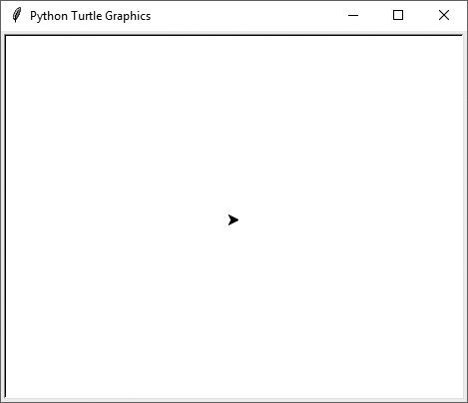
Introduction to Turtle Graphics (1 of 2)
Python's turtle graphics system displays a small cursor known as a turtle.
You can use Python statements to move the turtle around the screen, drawing lines and shapes.

Slide 49
Introduction to Turtle Graphics (2 of 2)
To use the turtle graphics system, you must import the turtle module with this statement: import turtle This loads the turtle module into memory

Slide 50
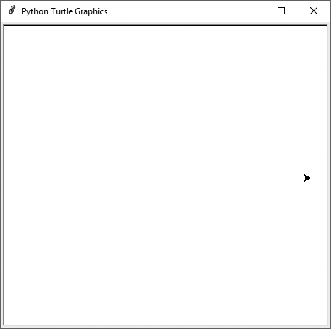
Moving the Turtle Forward
Use the turtle.forward(n) statement to move the turtle forward n pixels.
>>> import turtle
>>> turtle.forward(100)
>>>

Slide 51
Turning the Turtle (1 of 3)
The turtle's initial heading is 0 degrees (east)
Use the turtle.right(angle) statement to turn the turtle right by angle degrees.
Use the turtle.left(angle) statement to turn the turtle left by angle degrees.

Slide 52
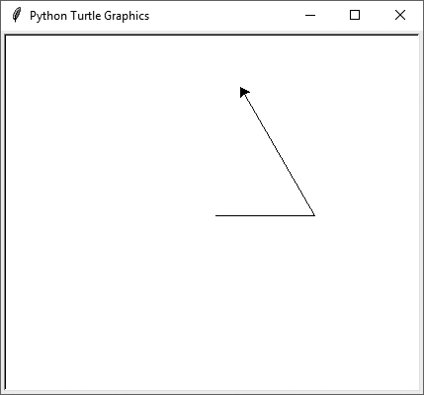
Turning the Turtle (2 of 3)
>>> import turtle
>>> turtle.forward(100)
>>> turtle.left(90)
>>> turtle.forward(100)
>>>

Slide 53
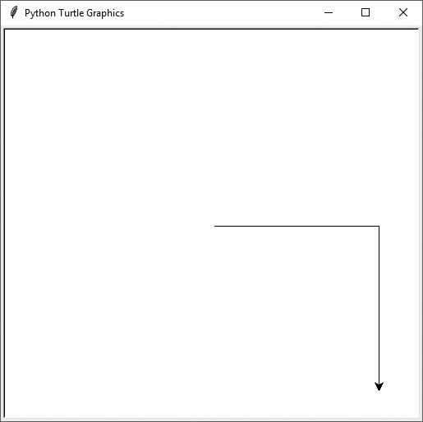
Turning the Turtle (3 of 3)
>>> import turtle
>>> turtle.forward(100)
>>> turtle.right(45)
>>> turtle.forward(100)
>>>

Slide 54
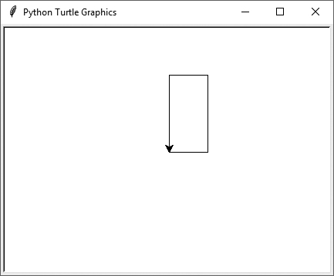
Setting the Turtle's Heading
Use the turtle.setheading(angle) statement to set the turtle's heading to a specific angle.
>>> import turtle
>>> turtle.forward(50)
>>> turtle.setheading(90)
>>> turtle.forward(100)
>>> turtle.setheading(180)
>>> turtle.forward(50)
>>> turtle.setheading(270)
>>> turtle.forward(100)
>>>

Slide 55
Setting the Pen Up or Down (1 of 2)
When the turtle's pen is down, the turtle draws a line as it moves. By default, the pen is down.
When the turtle's pen is up, the turtle does not draw as it moves.
Use the turtle.penup() statement to raise the pen.
Use the turtle.pendown() statement to lower the pen.

Slide 56
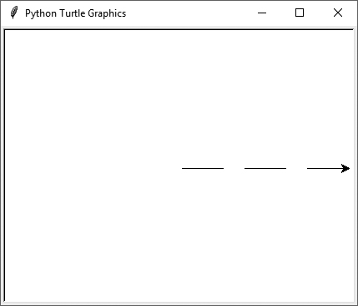
Setting the Pen Up or Down (2 of 2)
>>> import turtle
>>> turtle.forward(50)
>>> turtle.penup()
>>> turtle.forward(25)
>>> turtle.pendown()
>>> turtle.forward(50)
>>> turtle.penup()
>>> turtle.forward(25)
>>> turtle.pendown()
>>> turtle.forward(50)
>>>

Slide 57
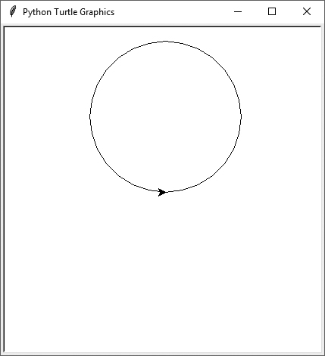
Drawing Circles
Use the turtle.circle(radius) statement to draw a circle with a specified radius.
>>> import turtle
>>> turtle.circle(100)
>>>

Slide 58
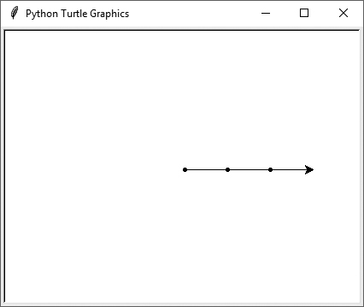
Drawing Dots
Use the turtle.dot() statement to draw a simple dot at the turtle's current location.
>>> import turtle
>>> turtle.dot()
>>> turtle.forward(50)
>>> turtle.dot()
>>> turtle.forward(50)
>>> turtle.dot()
>>> turtle.forward(50)
>>>

Slide 59
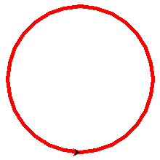
Changing the Pen Size and Drawing Color
Use the turtle.pensize(width) statement to change the width of the turtle's pen, in pixels.
Use the turtle.pencolor(color) statement to change the turtle's drawing color.
See Appendix D in your textbook for a complete list of colors.
>>> import turtle
>>> turtle.pensize(5)
>>> turtle.pencolor('red')
>>> turtle.circle(100)
>>>

Slide 60
Working with the Turtle's Window
Use the turtle.bgcolor(color) statement to set the window's background color.
See Appendix D in your textbook for a complete list of colors.
Use the turtle.setup(width,height)statement to set the size of the turtle's window, in pixels.
The width and height arguments are the width and height, in pixels.
For example, the following interactive session creates a graphics window that is 640 pixels wide and 480 pixels high:
>>> import turtle
>>> turtle.setup(640, 480)
>>>

Slide 61
Resetting the Turtle’s Window (1 of 3)
The turtle.reset() statement:
Erases all drawings that currently appear in the graphics window.
Resets the drawing color to black.
Resets the turtle to its original position in the center of the screen.
Does not reset the graphics window’s background color.

Slide 62
Resetting the Turtle’s Window (2 of 3)
The turtle.clear() statement:
Erases all drawings that currently appear in the graphics window.
Does not change the turtle's position.
Does not change the drawing color.
Does not change the graphics window’s background color.

Slide 63
Resetting the Turtle’s Window (3 of 3)
The turtle.clearscreen() statement:
Erases all drawings that currently appear in the graphics window.
Resets the drawing color to black.
Resets the turtle to its original position in the center of the screen.
Resets the graphics window’s background color to white.

Slide 64
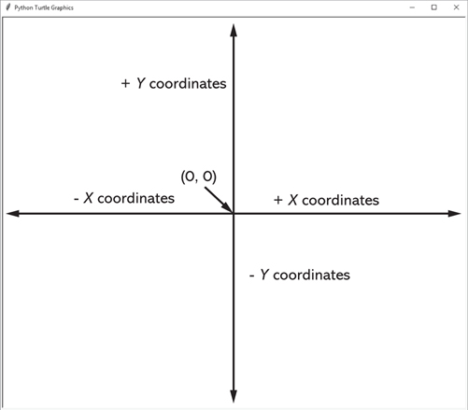
Working with Coordinates
The turtle uses Cartesian Coordinates

Slide 65
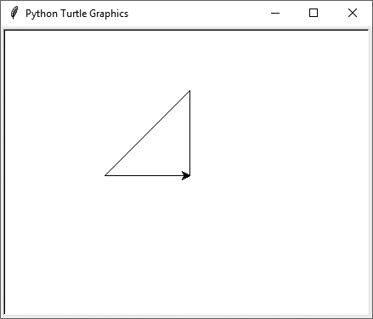
Moving the Turtle to a Specific Location
Use the turtle.goto(x, y) statement to move the turtle to a specific location.
>>> import turtle
>>> turtle.goto(0, 100)
>>> turtle.goto(−100, 0)
>>> turtle.goto(0, 0)
>>>
The turtle.pos() statement displays the turtle's current X,Y coordinates.
The turtle.xcor() statement displays the turtle's current X coordinate and the turtle.ycor() statement displays the turtle's current Y coordinate.

Slide 66
Animation Speed
Use the turtle.speed(speed) command to change the speed at which the turtle moves.
The speed argument is a number in the range of 0 through 10.
If you specify 0, then the turtle will make all of its moves instantly (animation is disabled).

Slide 67
Hiding and Displaying the Turtle
Use the turtle.hideturtle() command to hide the turtle.
This command does not change the way graphics are drawn, it simply hides the turtle icon.
Use the turtle.showturtle() command to display the turtle.

Slide 68
Displaying Text (1 of 2)
Use the turtle.write(text) statement to display text in the turtle's graphics window.
The text argument is a string that you want to display.
The lower-left corner of the first character will be positioned at the turtle’s X and Y coordinates.

Slide 69
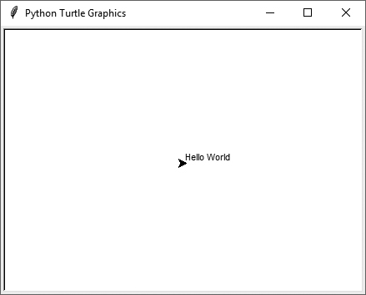
Displaying Text (2 of 2)
>>> import turtle
>>> turtle.write('Hello World')
>>>

Slide 70
Filling Shapes (1 of 2)
To fill a shape with a color:
Use the turtle.begin_fill() command before drawing the shape
Then use the turtle.end_fill() command after the shape is drawn.
When the turtle.end_fill() command executes, the shape will be filled with the current fill color

Slide 71
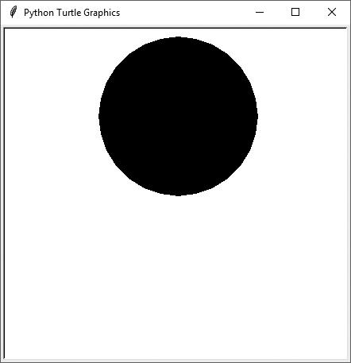
Filling Shapes (2 of 2)
>>> import turtle
>>> turtle.hideturtle()
>>> turtle.fillcolor('red')
>>> turtle.begin_fill()
>>> turtle.circle(100)
>>> turtle.end_fill()
>>>

Slide 72
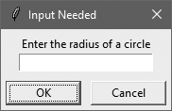
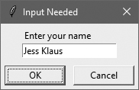
Getting Input With a Dialog Box (1 of 2)
>>> import turtle
>>> age = turtle.numinput('Input', 'Enter your age')
>>> import turtle
>>> name = turtle.textinput('Input', 'Enter your name')

Slide 73
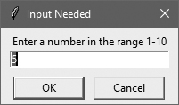
Getting Input With a Dialog Box (2 of 2)
Specifying a default value, minimum value, and maximum value with turtle.numinput:
An error message will be displayed if the input is less than minval or greater than maxval
>>> import turtle
>>> num = turtle.numinput('Input', 'Enter a number',
default=10, minval=0, maxval=100)

Slide 74
Keeping the Graphics Window Open
When running a turtle graphics program outside IDLE, the graphics window closes immediately when the program is done.
To prevent this, add the turtle.done() statement to the very end of your turtle graphics programs.
This will cause the graphics window to remain open, so you can see its contents after the program finishes executing.

Slide 75
Summary
This chapter covered:
The program development cycle, tools for program design, and the design process
Ways in which programs can receive input, particularly from the keyboard
Ways in which programs can present and format output
Use of comments in programs
Uses of variables and named constants
Tools for performing calculations in programs
The turtle graphics system

